Slide 1


Slide 2
PROBLEM
People who are speech-impaired face difficulty in communicating with others who do not know the sign language or their gestures . Due to lack in communication they face several disadvantages

Slide 3
SOLUTION
Our product converts gestures (standard Indian sign language ) into audio output by using a glove to read data . We use machine learning to generate the output .

Slide 4
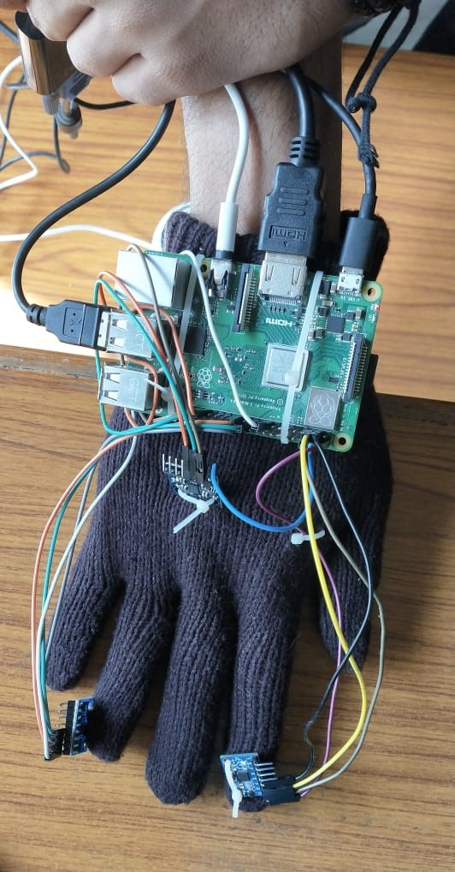
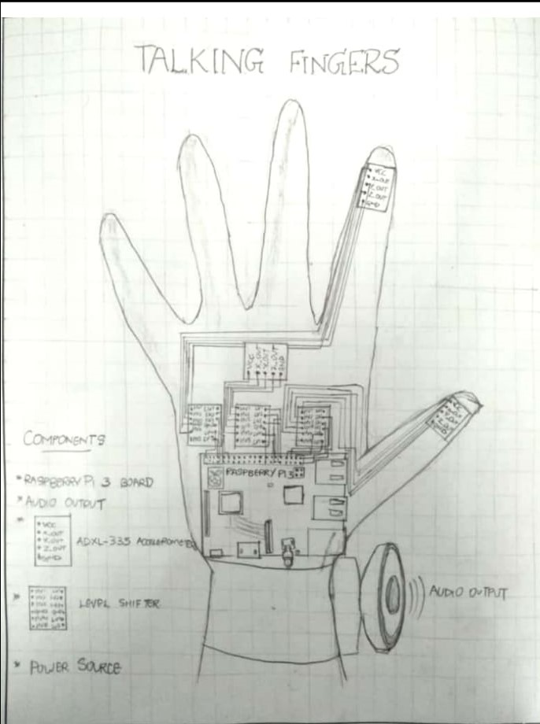
WORKING
The talking fingers project can be done using MPU6050 accelerometer sensor, to create and record a gesture used in the sign language .The recorded gestures can be input into a algorithm to recognize a new gesture and compare it with already stored gestures. This gesture will be given an audio output, and vice-versa we also created an app that helps millions of deaf and dumb people around the world

Slide 5
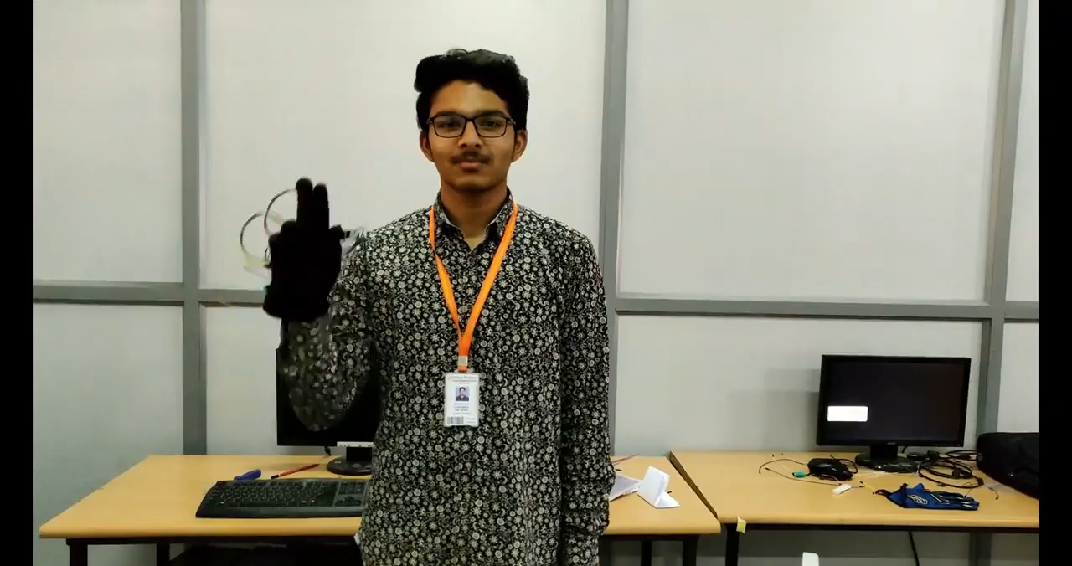

Slide 6
VALUE STATEMENT
For speech-impaired people
Who are dissatisfied with communicating with others.
Our product is a glove which converts gestures to speech.
That provides communication
Unlike text to speech.

Slide 7
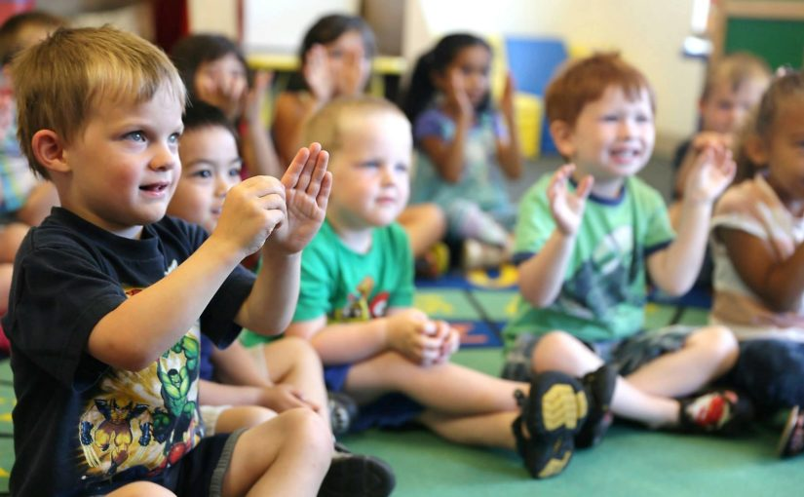
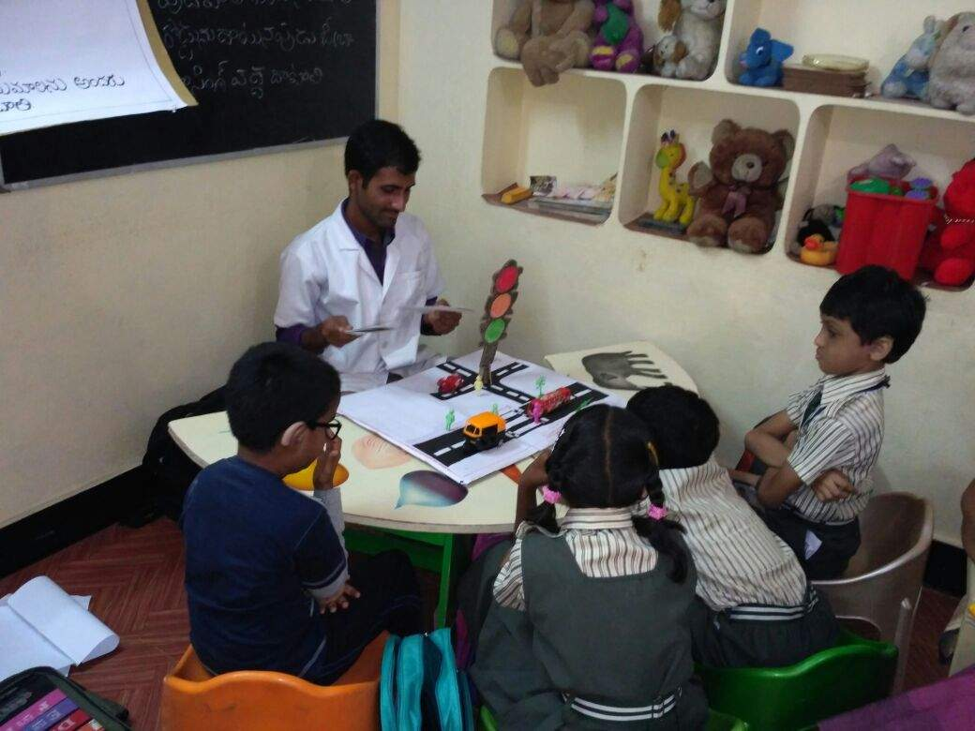
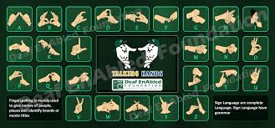

MARKET
Our customers are the speech-impaired people.
prospective customers are mostly parents of speech-impaired children ,the organisations ,NGO’s and schools that take care of the specially impaired people and the trainers who train speech-impaired people and old people who face difficulty while communicating .

Slide 8
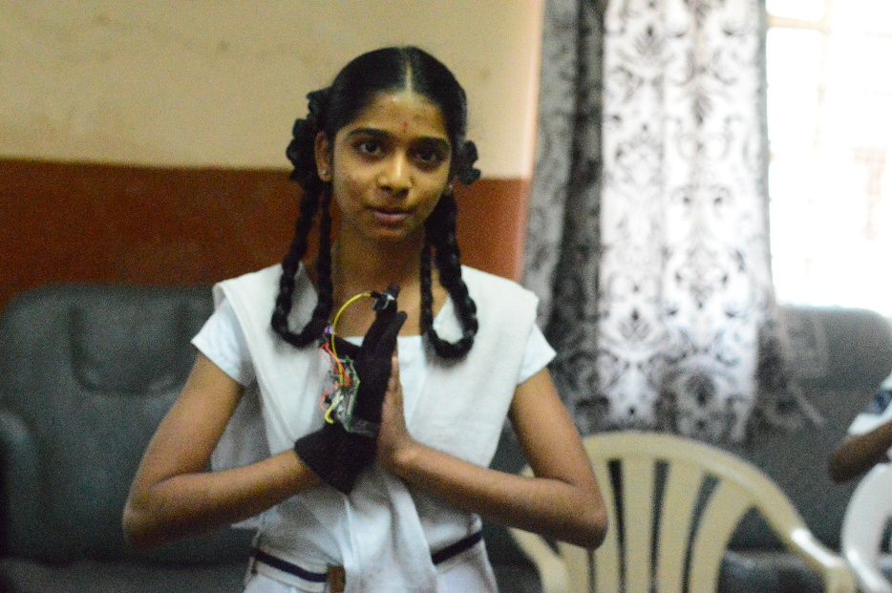
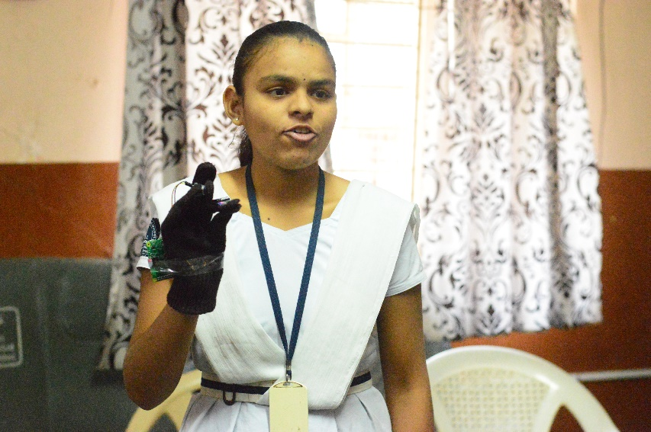
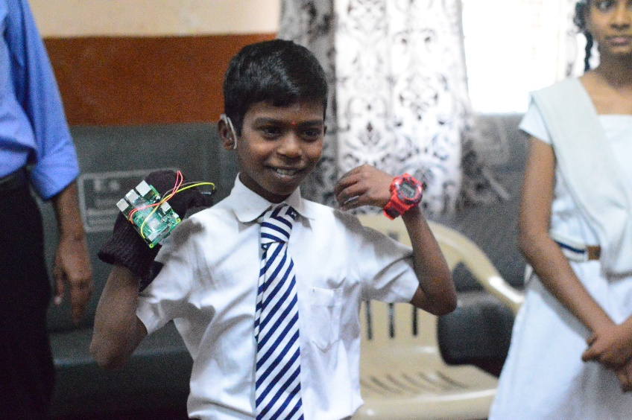
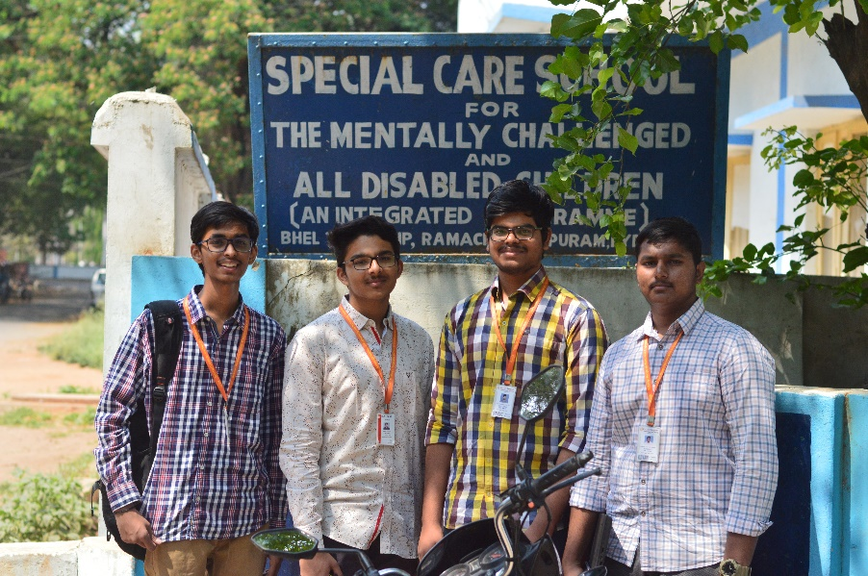

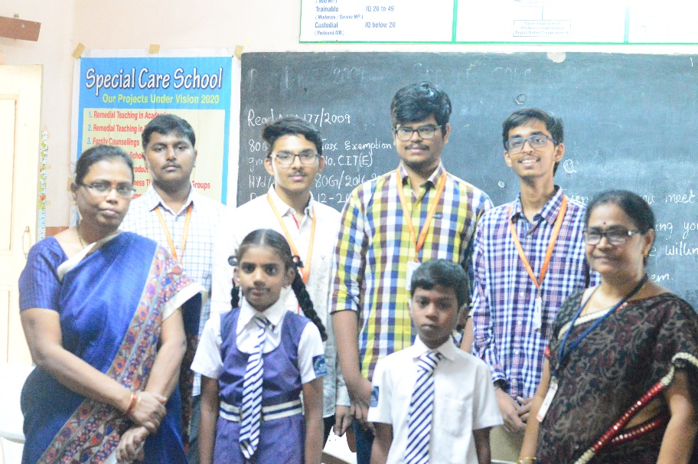
MARKET RESEARCH

Slide 9
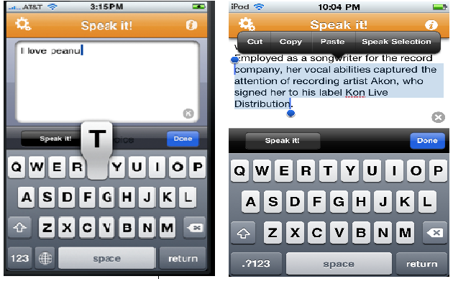

COMPETITION :
Our competitors are text to speech applications , translators who help others for communication and applications which use digital image processing for gesture to audio output.
Our product uses Machine learning to generate the audio output which makes it more efficient. No external sources like internet, smart phone and applications,etc are needed.

Slide 10
MARKETING STRATEGY
Our product is mostly useful for the speech-impaired people. There are around millions of speech-impaired people in this world (16,40,868 in India) who are facing difficulty to communication
reach out to them by word of mouth or by spreading awareness .
Our marketing channels
1. Direct selling
2. Selling through intermediaries

Slide 11
REVENUE MODEL
We will use Transaction-based revenue ( Proceeds from sales of goods that are usually one-time customer payments).
Cost of the product : Desired profit (20% on sales) = ₹ 471/unit
Source | Cost
sensors | 450
Power bank | 250
speaker | 150
microprocessor | 1000
Wiring and glove | 200
V.C per unit | 55
Tech person | 100
Non tech | 50
idea | 100
TOTAL COST OF ONE UNIT | 2355
SALE PRICE(20%PROFIT) | 2826

Slide 12
FINANCIALS
Investment required = ₹ 45,00,000
Month-wise revenue for at least one year would be around ₹ 3,16,000 (400 units per month).
Assumptions are there would be 400+ units are sold every month
BEP = 12 months

Slide 13
TEAM
P GOWTHAM SAI
K BHARATH VARMA
B Jaswanth kranthi
B.Tech 1st year, GRIET.
CSE
CODING
MARKET RESEARCH
INTEGRATION
B.Tech 1st year, GRIET.
ECE.
CODING
HARDWARE
MARKET RESEARCH
LEADER
B.Tech 1st year, GRIET.
ECE.
COMPONENTS
HARDWARE
DESIGN

Slide 14
Q & A

